Slide 1
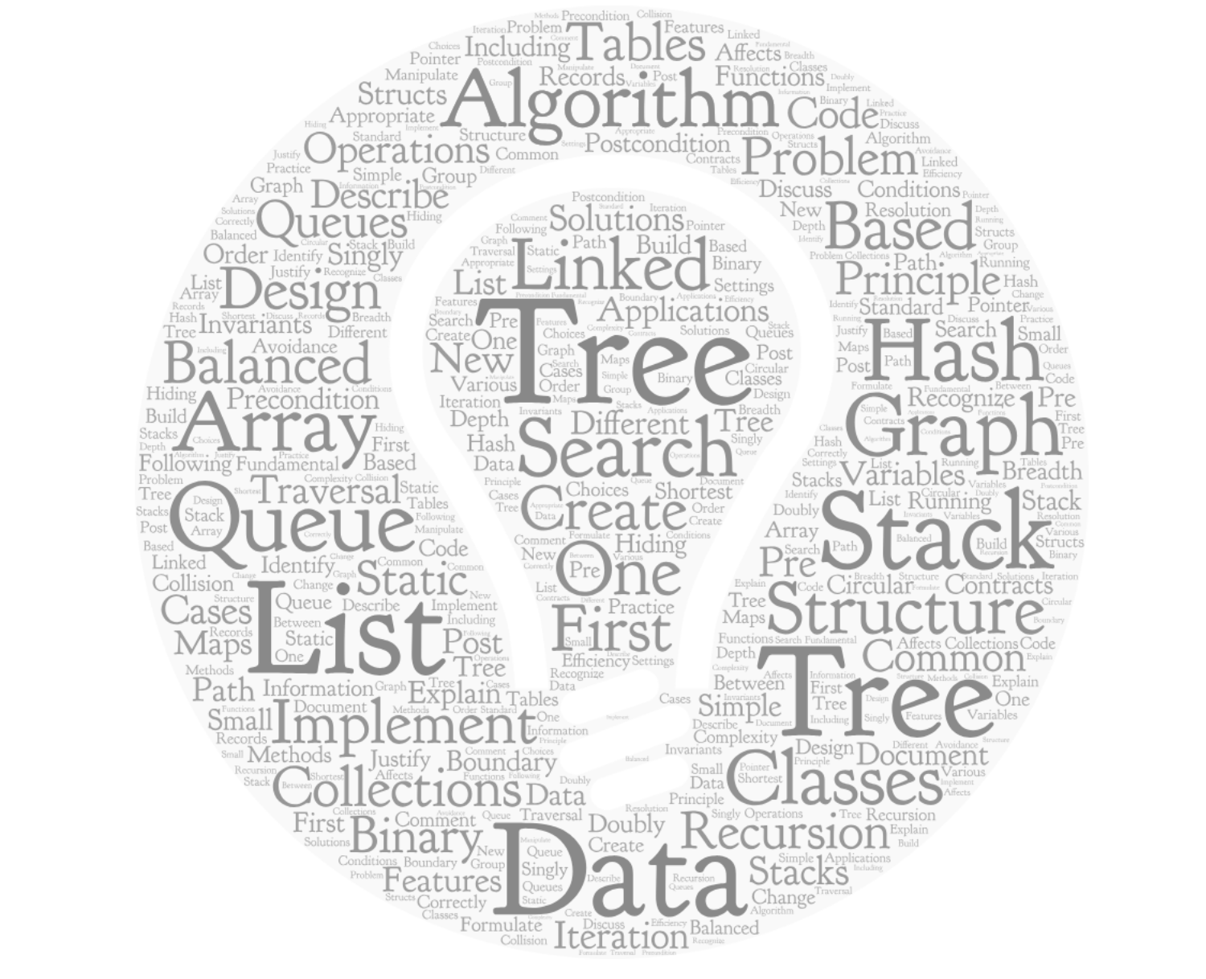
CSCI 2270: Data Structures
Lecture 12: Algorithms and Complexity
Ashutosh Trivedi (ashutosh.trivedi@colorado.edu)
Department of Computer Science, University of Colorado Boulder

Slide 2
Algorithm

Slide 3
Sequence of computational steps
A recipe to solve a computational problem
Input to output specification

Slide 4
A recipe for automation

Slide 5
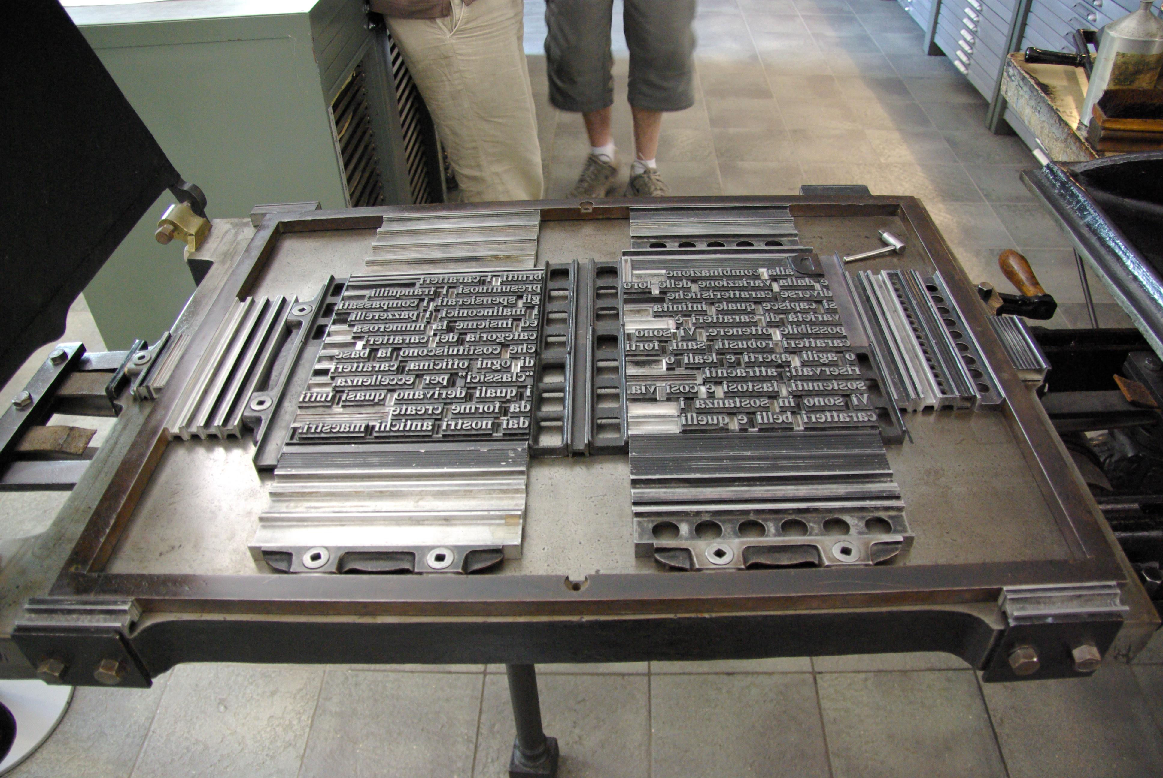
Notes:
s

Slide 6
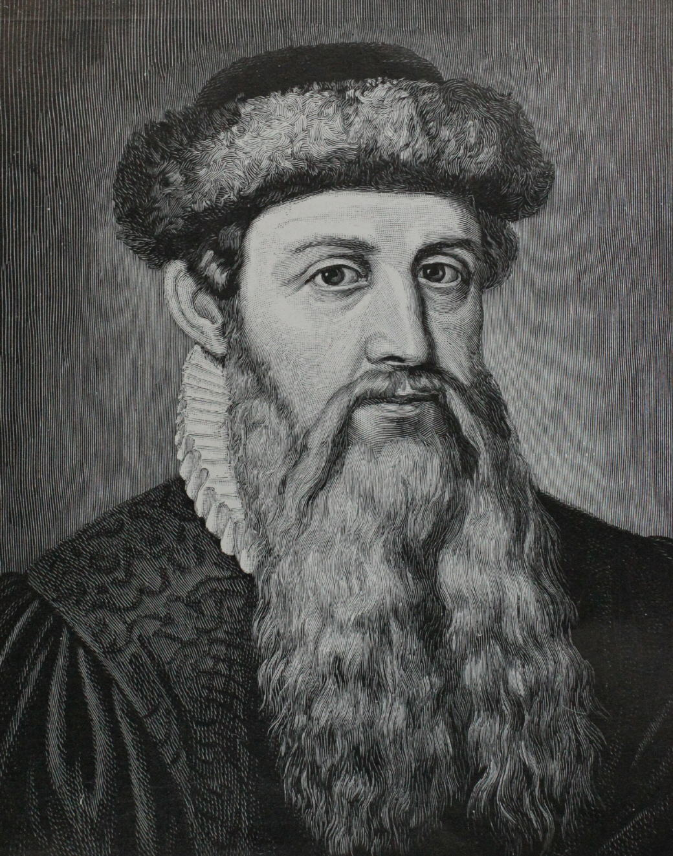
Johannes Gutenberg introduced mechanical movable type printing to Europe in 1448

Slide 7
MCDXLVII + DCCCXII

Slide 8
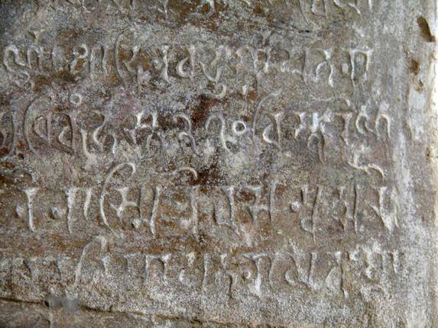
The oldest inscription with decimal system, c. 850 AD, Gwalior, India

Slide 9
1448 + 812

Slide 10
1
1
1448
+ 812
2260

Slide 11
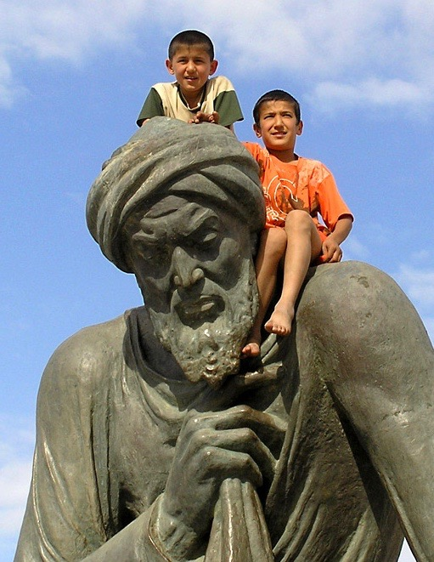
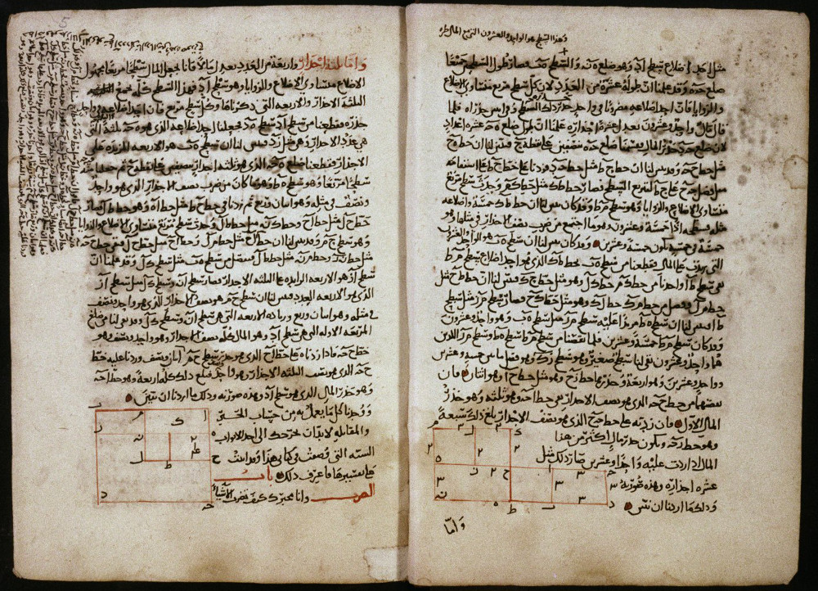
Muhammad al-Khwarizmi (c. 780 – c. 850) wrote a textbook that popularized decimal numbers and “algorithms” for adding, multiplying, dividing them.

Slide 12
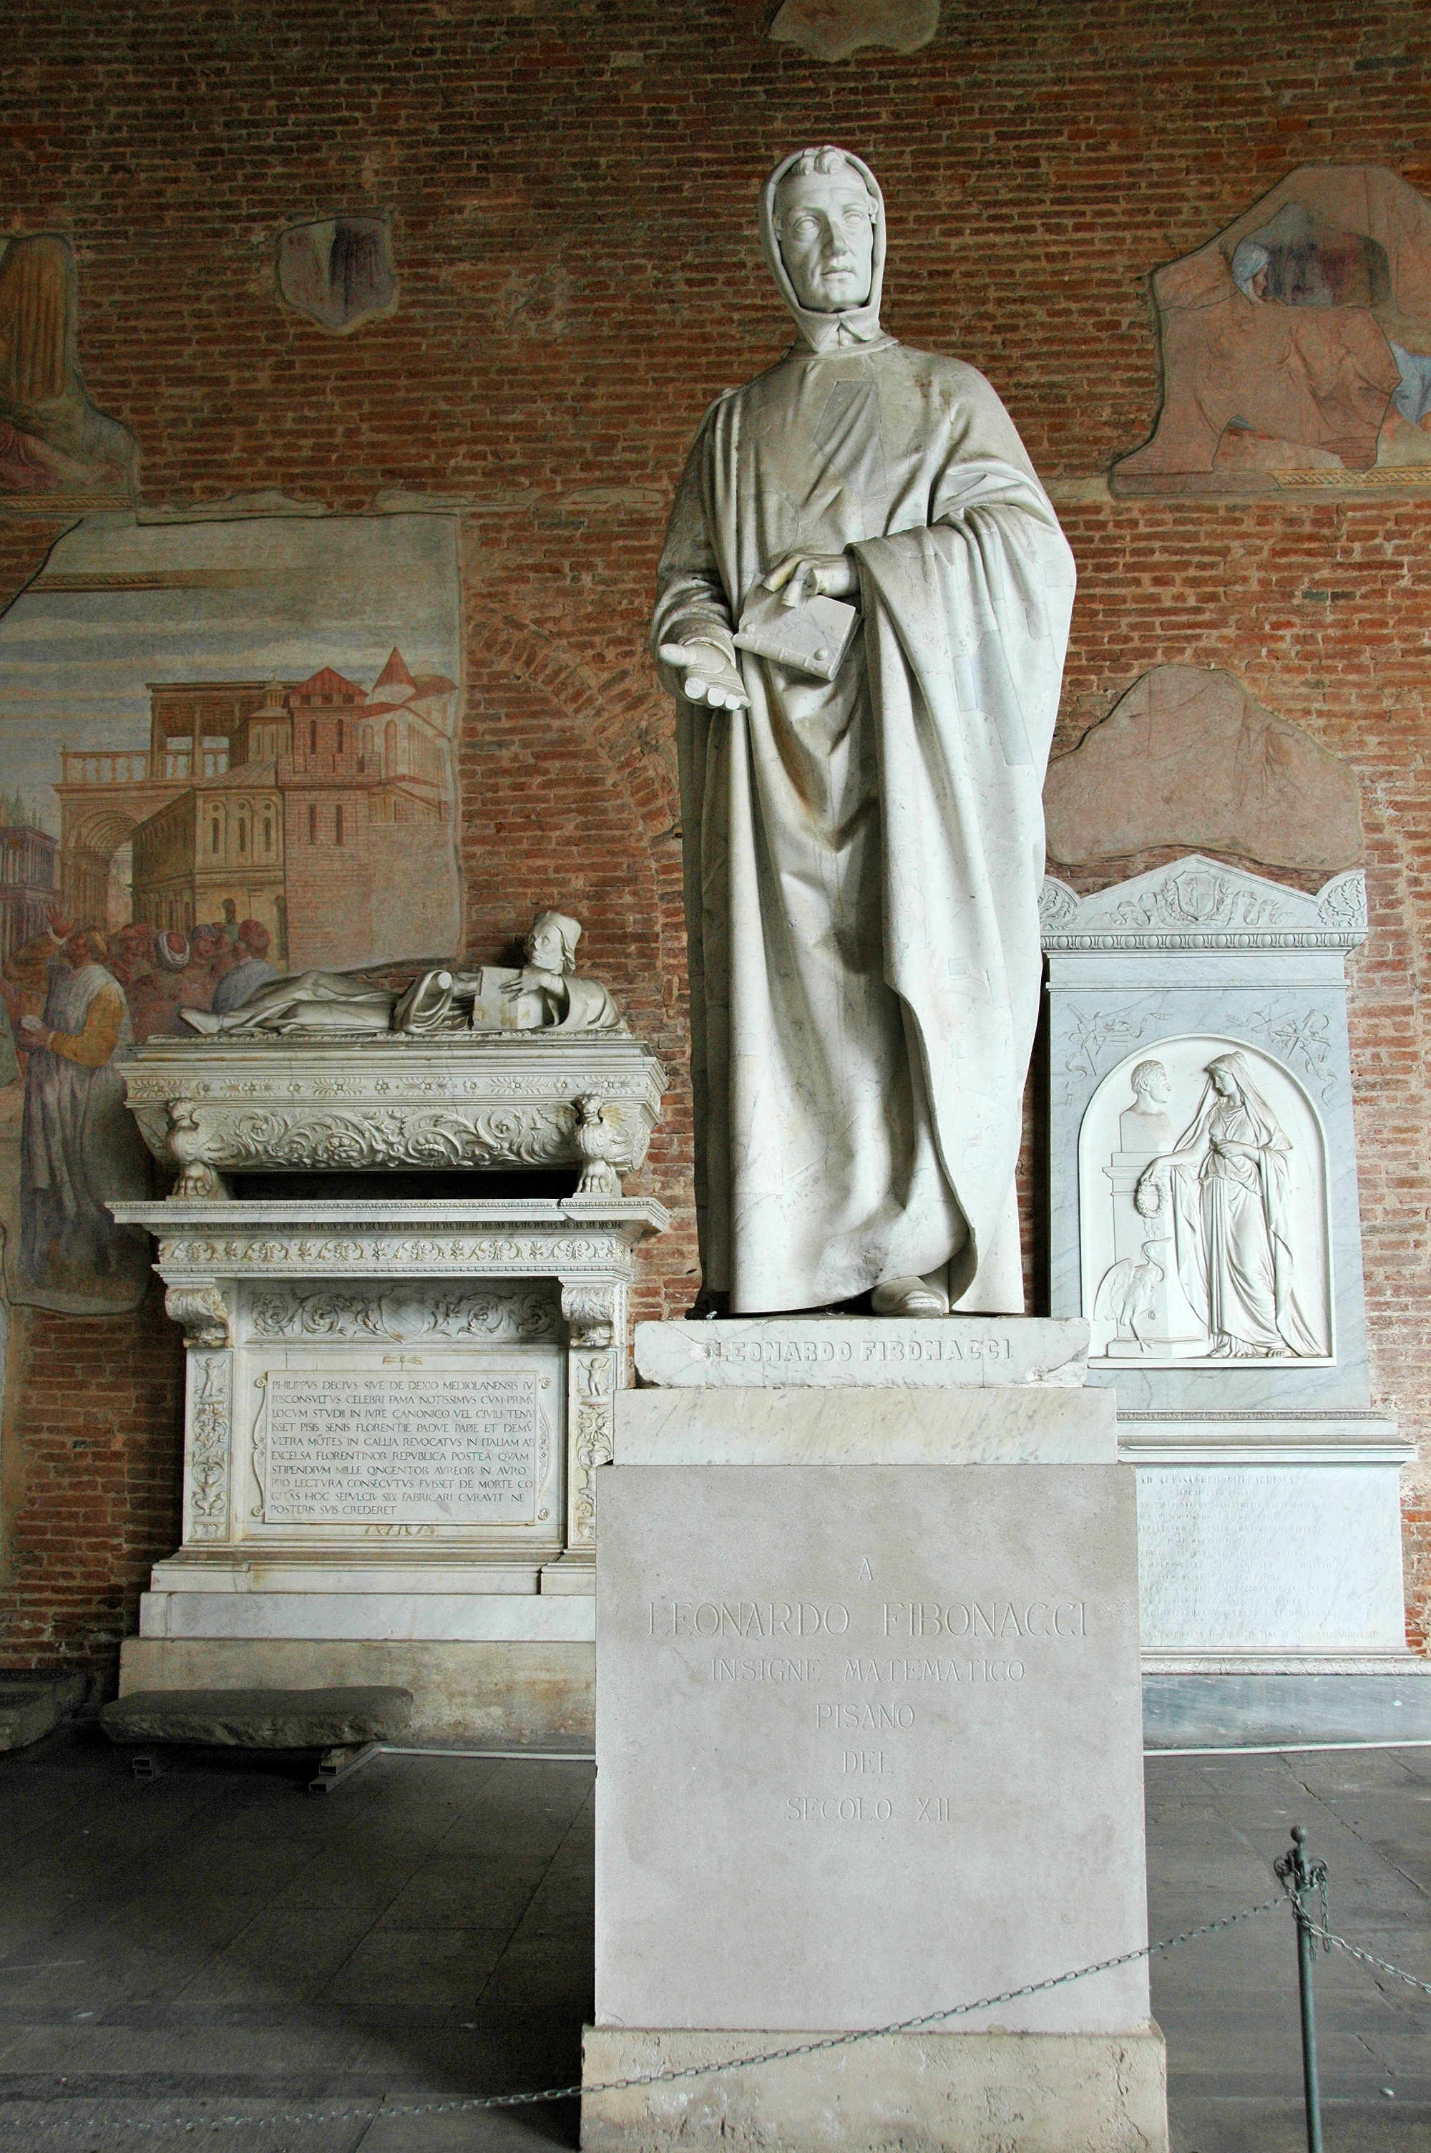
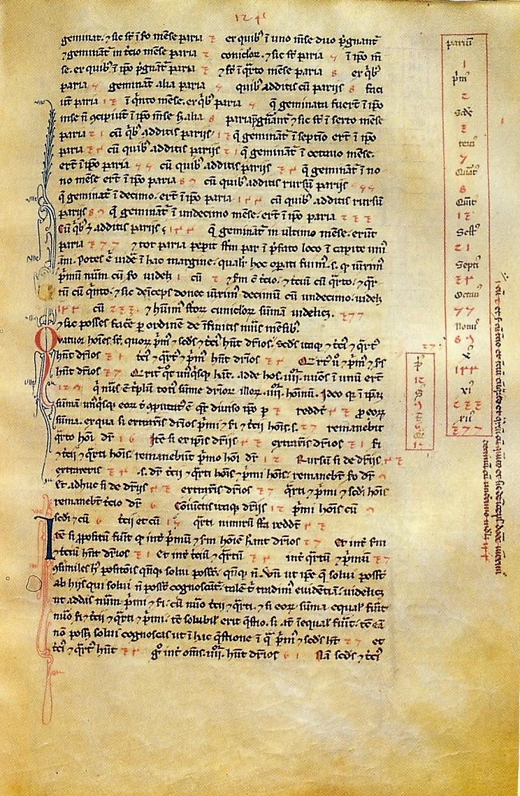
Leonardo Fibonacci (c. 1175 – c. 1240) popularized decimal number system in Europe.

Slide 13
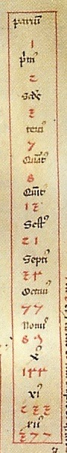
$$1, 2, 3, 5, 8,13, 21,34, 55,89, 144, 233, 377, …$$
Second popular sequence in CS!

Slide 14
Fibonacci sequence grows as fast as powers of 2 sequence…

Slide 15
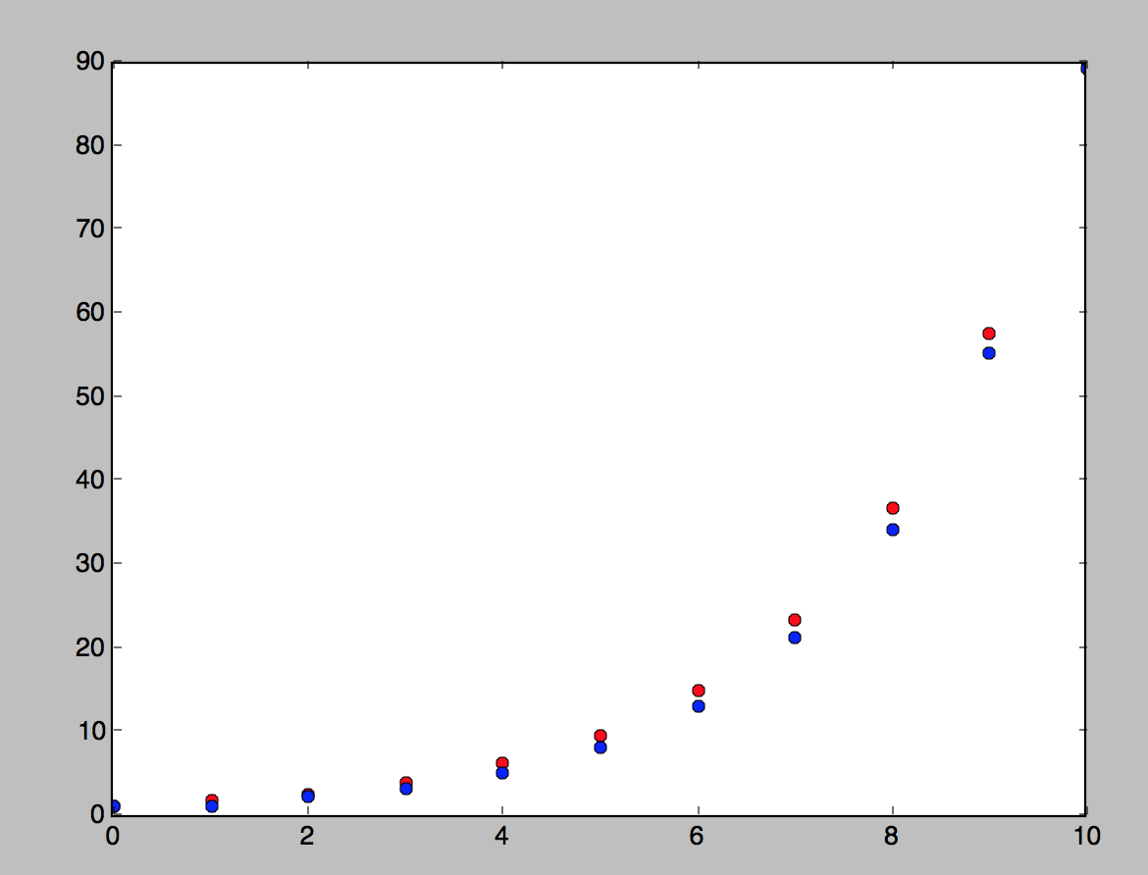

$$F_{n} = 2^{0.694∗n}$$

Slide 16
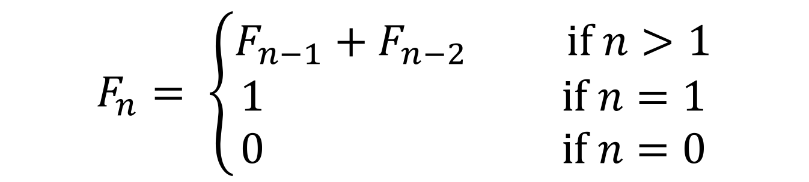
$$F_{n}= \left\{\begin{aligned}F_{n−1}+F_{n−2} if n>1 \\ 1 if n=1 \\ 0 if n=0\end{aligned}\right.$$
Let’s write an algorithm to compute $F_{n}.$

Slide 17
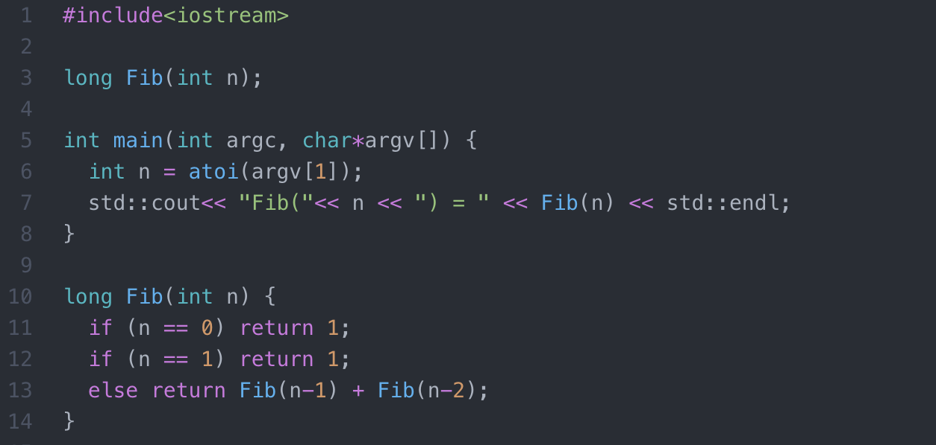

Slide 18

Is it correct?
Can we do better?
How much time does it take?
Let’s analyze this algorithm!
$$F_{n}= \left\{\begin{aligned}F_{n−1}+F_{n−2} if n>1 \\ 1 if n=1 \\ 0 if n=0\end{aligned}\right.$$

Slide 19
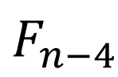
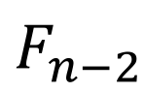
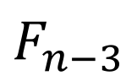
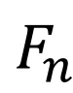
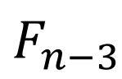
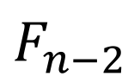
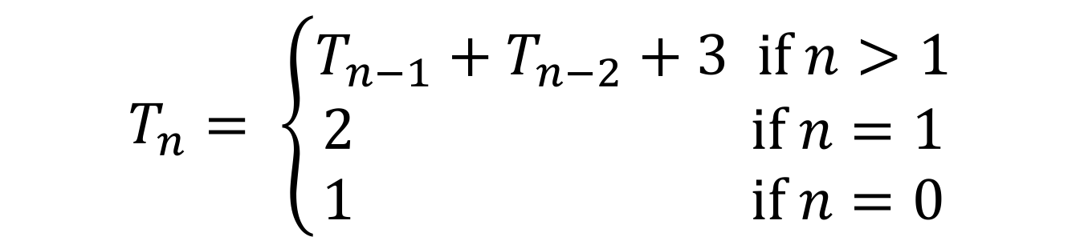
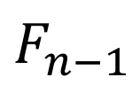
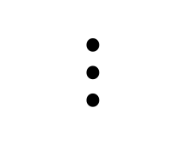
$$F_{n}$$
$$F_{n−1}$$
$$F_{n−2}$$
$$F_{n−2}$$
$$F_{n−3}$$
$$F_{n−3}$$
$$F_{n−4}$$
$$⋮$$
$$T_{n}= \left\{\begin{aligned}T_{n−1}+T_{n−2}+3 if n>1 \\ 2 if n=1 \\ 1 if n=0\end{aligned}\right.$$

Slide 20
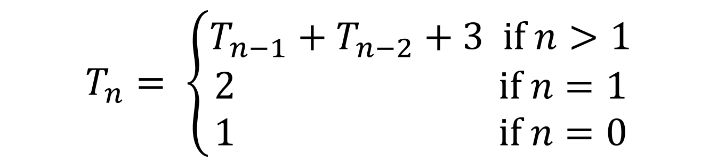
$$T_{n}= \left\{\begin{aligned}T_{n−1}+T_{n−2}+3 if n>1 \\ 2 if n=1 \\ 1 if n=0\end{aligned}\right.$$
With $n$Algorithm time grows faster than Fibonacci sequence!!!!!

Slide 21
Exponential

Slide 22
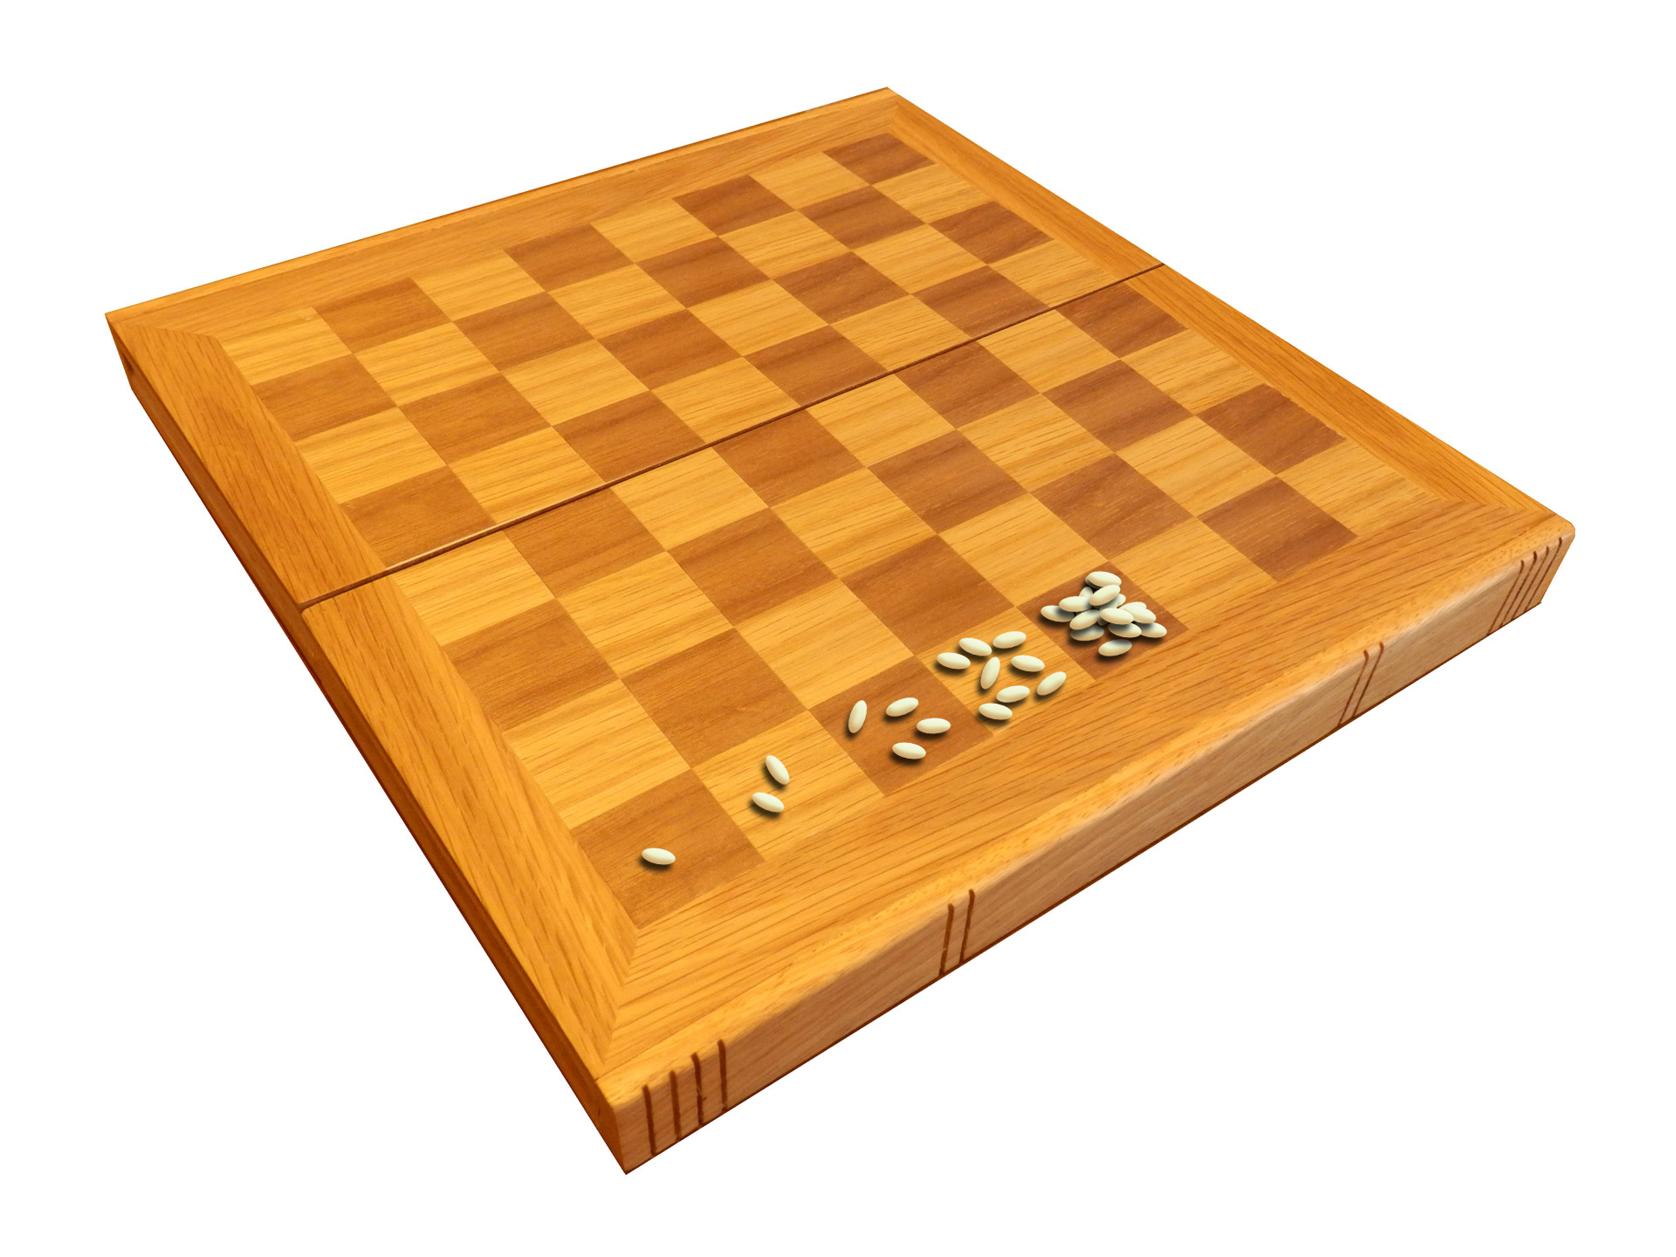

Slide 23
Is it correct?
Can we do better?
How much time does it take?
Let’s analyze this algorithm!
$$F_{n}= \left\{\begin{aligned}F_{n−1}+F_{n−2} if n>1 \\ 1 if n=1 \\ 0 if n=0\end{aligned}\right.$$

Slide 24
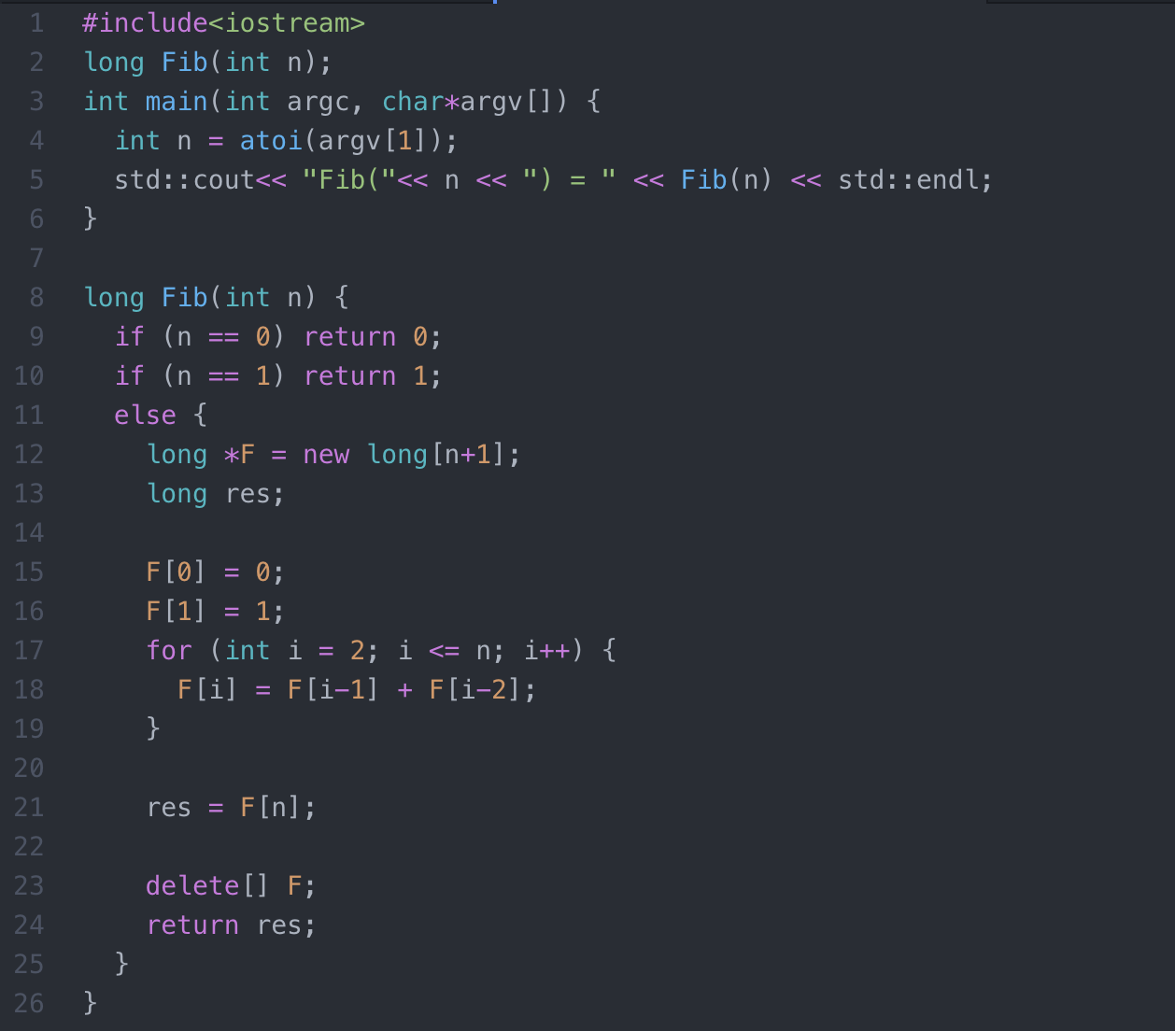

$$F_{n}= \left\{\begin{aligned}F_{n−1}+F_{n−2} if n>1 \\ 1 if n=1 \\ 0 if n=0\end{aligned}\right.$$

Slide 25
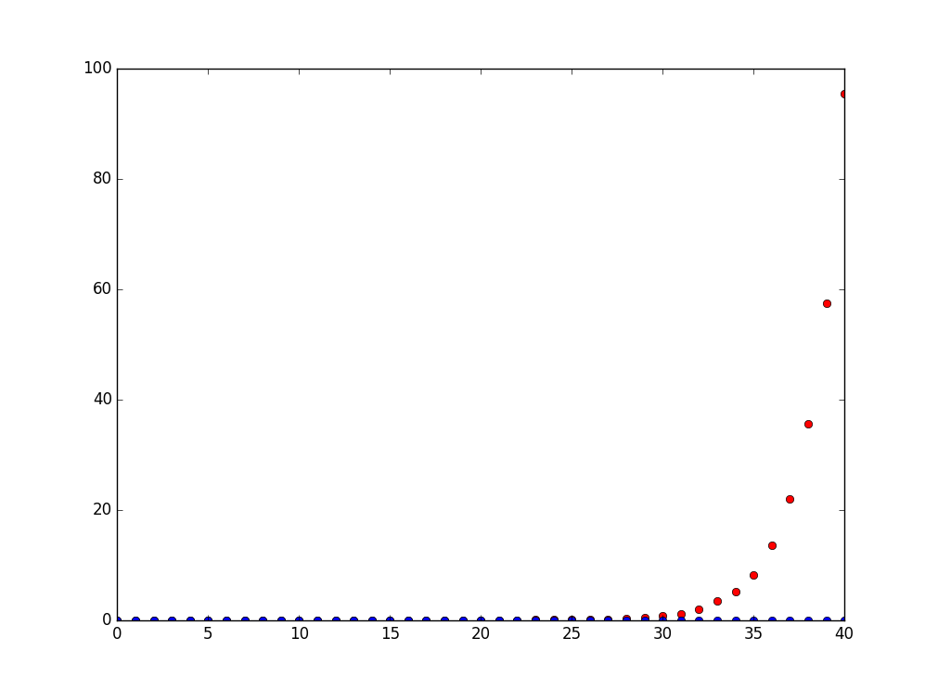
fib1 vs fib2

Slide 26
Is it correct?
Can we do better?
How much time does it take?
Let’s analyze this algorithm!
$$F_{n}= \left\{\begin{aligned}F_{n−1}+F_{n−2} if n>1 \\ 1 if n=1 \\ 0 if n=0\end{aligned}\right.$$

Slide 27
$$T_{n}=c_{1}∗n=O(n)$$

Slide 28
Big-O

Slide 29
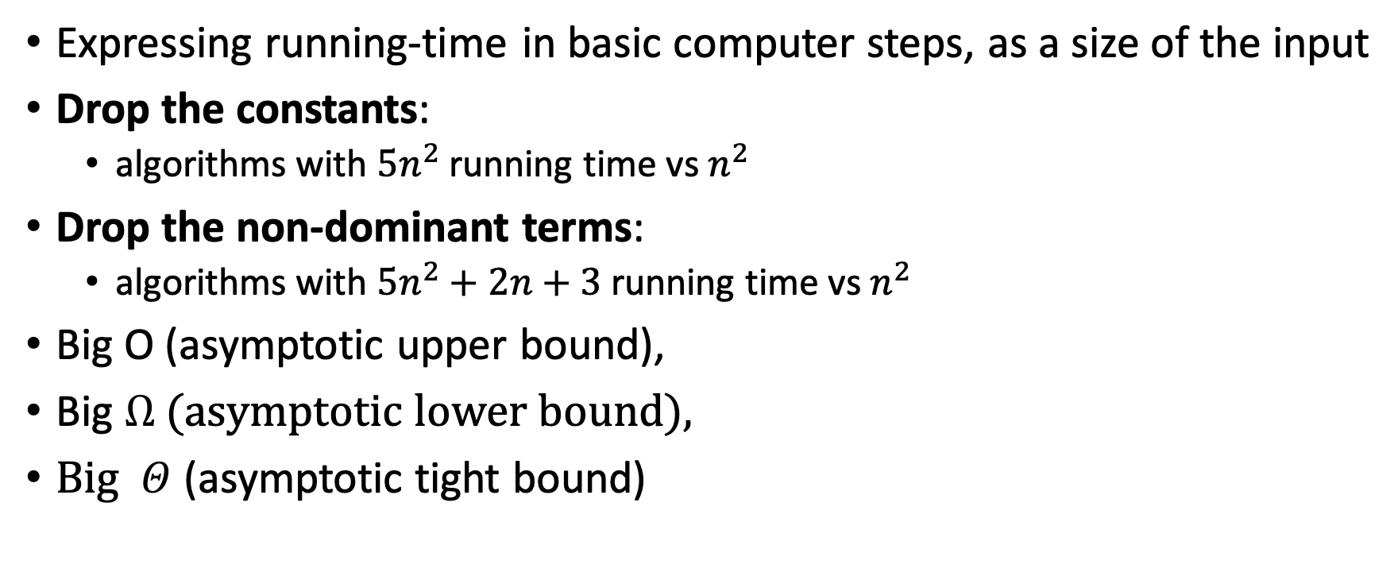
Asymptotic Notation
Expressing running-time in basic computer steps, as a size of the input
Drop the constants:
algorithms with $5n^{2}$ running time vs $n^{2}$
Drop the non-dominant terms:
algorithms with $5n^{2}+2n+3$ running time vs $n^{2}$
Big O (asymptotic upper bound),
Big $Ω$ (asymptotic lower bound),
Big $Θ$ (asymptotic tight bound)

Slide 30
Examples

Slide 31
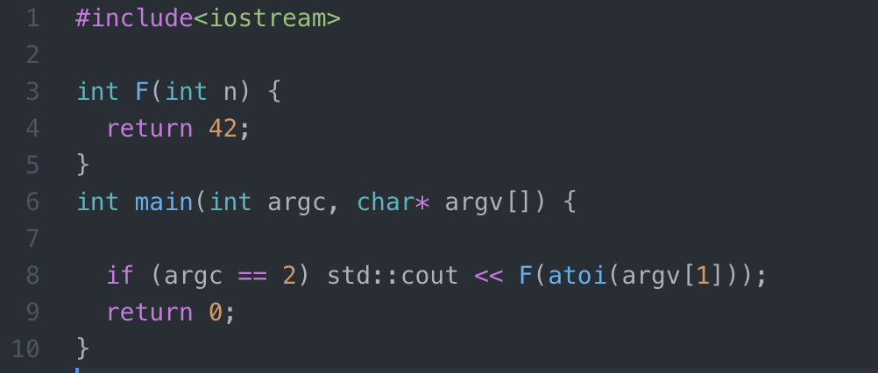
O(1) or constant- time

Slide 32
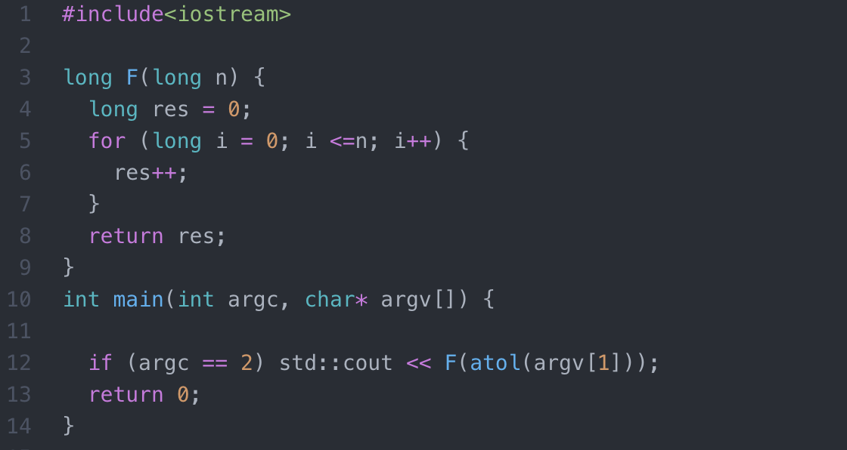
O(n) or linear- time

Slide 33
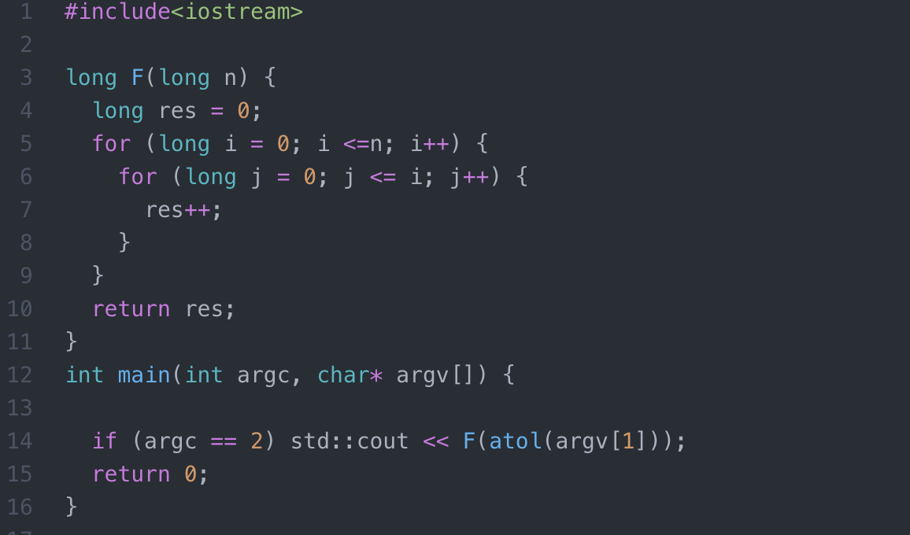
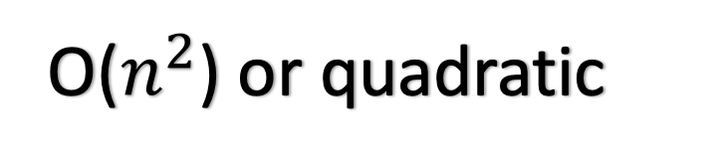
O($n^{2}$) or quadratic

Slide 34
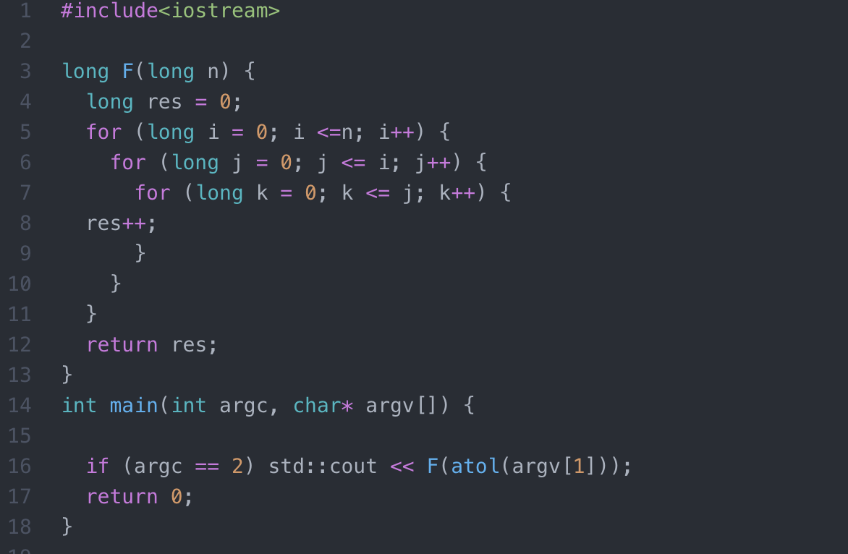
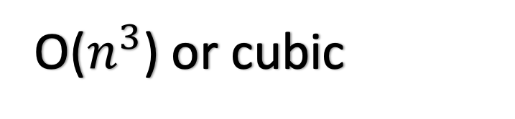
O($n^{3}$) or cubic

Slide 35
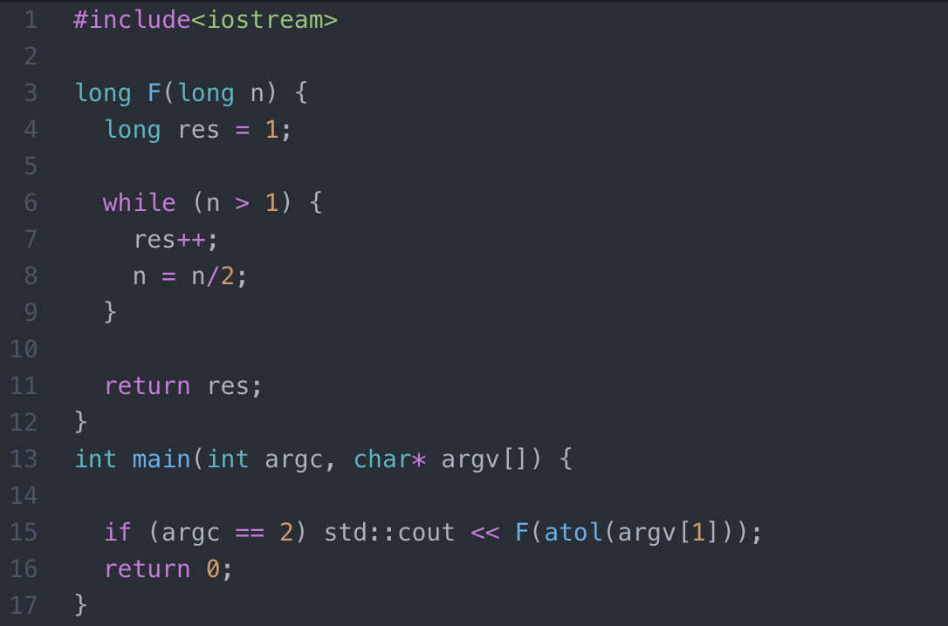
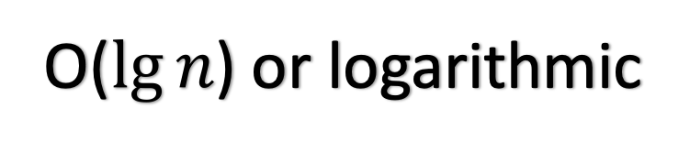
O($\lg{n}$) or logarithmic

Slide 36
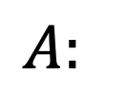
List, Stack, and Queues: Insert and Delete
$$A:$$
3
4
5
5
top

Slide 37
https://tinyurl.com/csci2270-100

Slide 38
